Slide 1
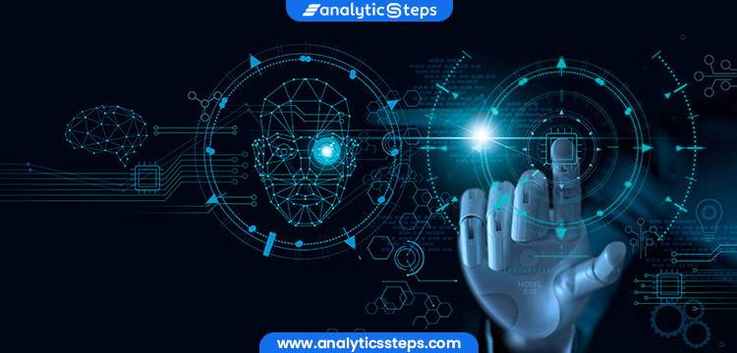
Automatic Image Recognition
SUBMITTED BY- SUBMITTED TO- MONISHKA SINGH (201500412) PARUL CHOUDHARY
DISHA AGRAWAL (201500225) (ASSISTANT PROFESSOR, GLAU)
DEEPA AGRAWAL (201500204)

Slide 2
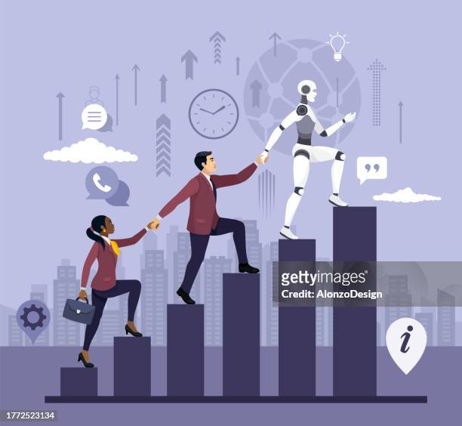
Artificial Intelligence &
Machine Learing
Recognition is the cornerstone of AIML revolution, Parsing human intent with precision, it's the solution. It's the bridge between language and machine cognition, Empowering AI to understand human communication.

Slide 3
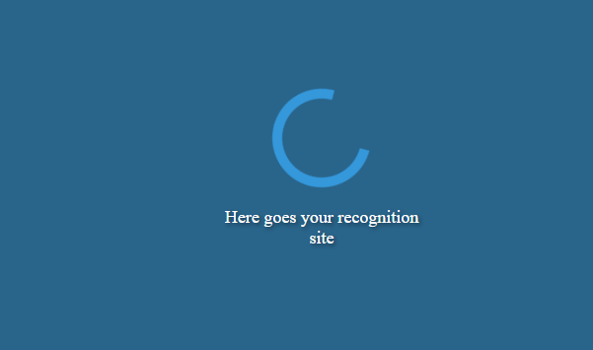
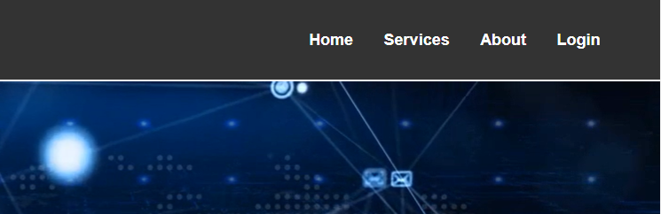
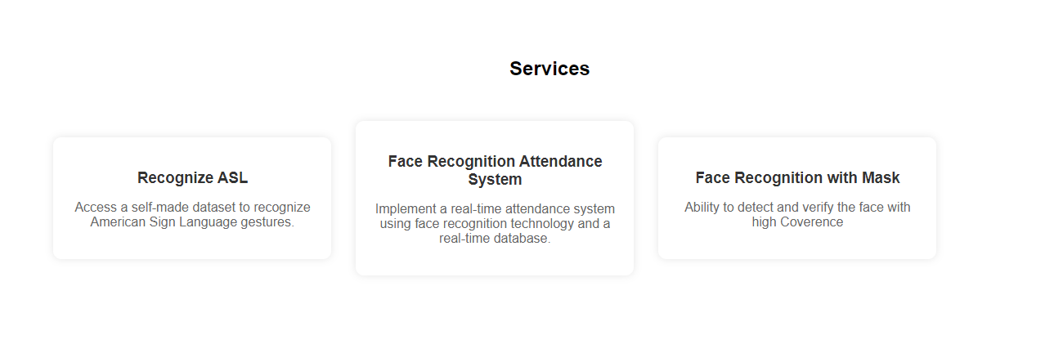
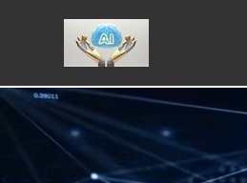
MLDL –Based Recognition Site
Using Django Framework connecting Various Projects to Integratedly Work as An Website along with templates

Slide 4
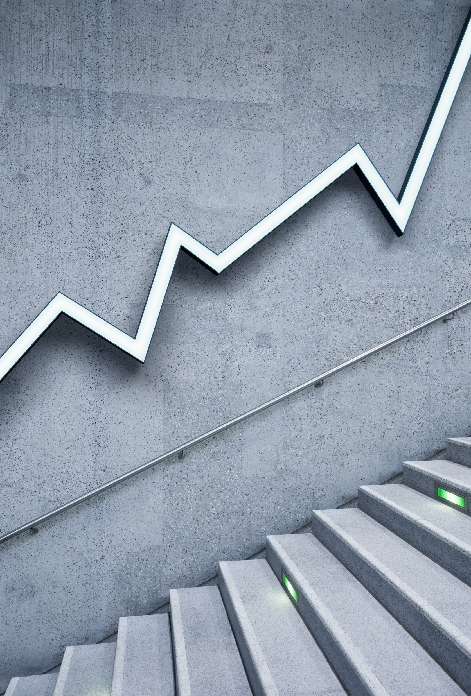
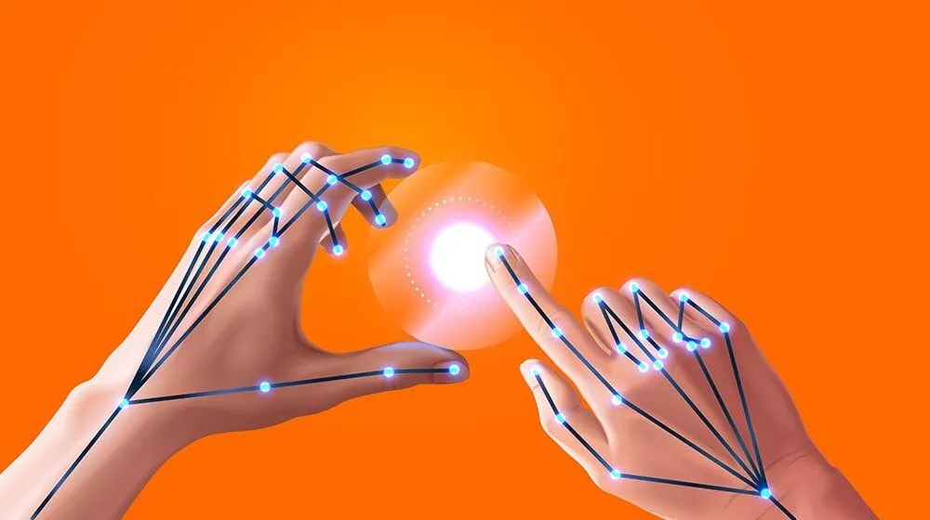
Hand Gesticulation
(using PythoN)
In our AIML journey, recognition is key, Using our own data and Python, we train with glee. Google Teachable helps our model learn to see, Understanding ASL signs, making communication free.

Slide 5
INTRODUCTION
WHAT ARE GESTURES
Non- Verbal Communication
Gives Message
A gesture is a way of communicating with people without engaging any verbal forms of language
Its widely used nowadays
The advancements in machine learning and data science have made this easier

Slide 6
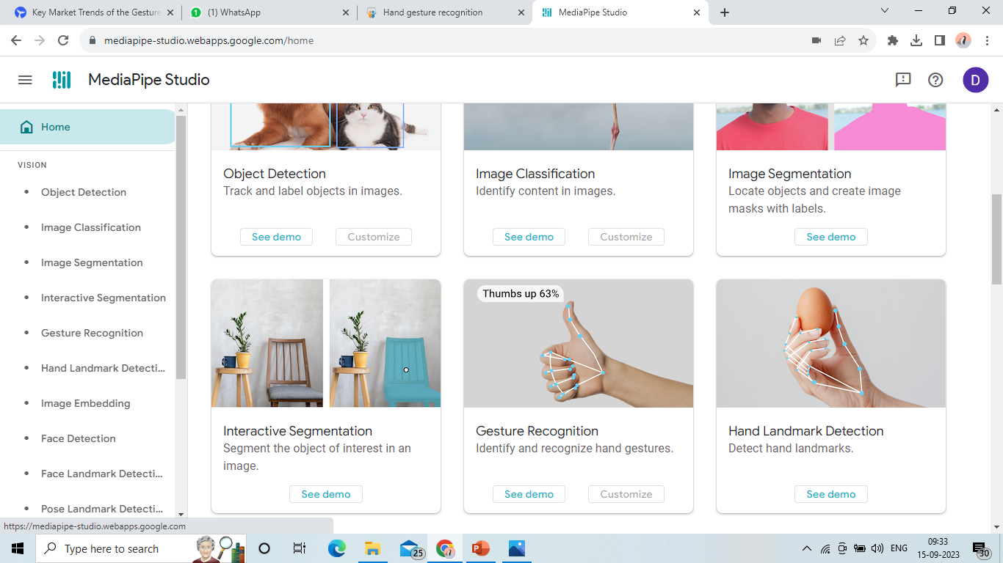
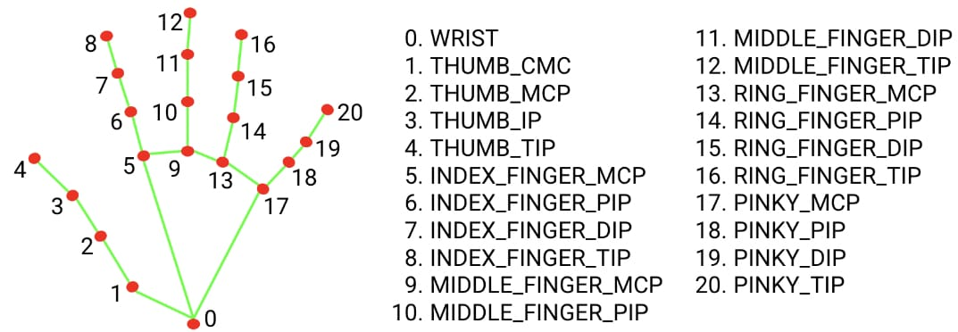
Hand-Gesture Recognition
Doing manual feature extraction using statistical functions of React.
These features were evaluated in classifiers such as SOFTMAX, ANN and SVM.
The best performing model was the combination of BiLSTM and ANN with 99.9912% accuracy
MediaPipe offers a hand tracking model that can provide hand landmark coordinates.

Slide 7
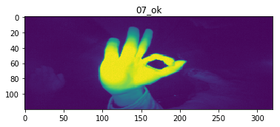
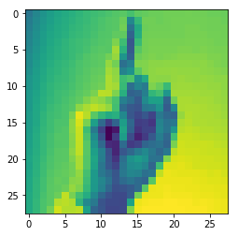
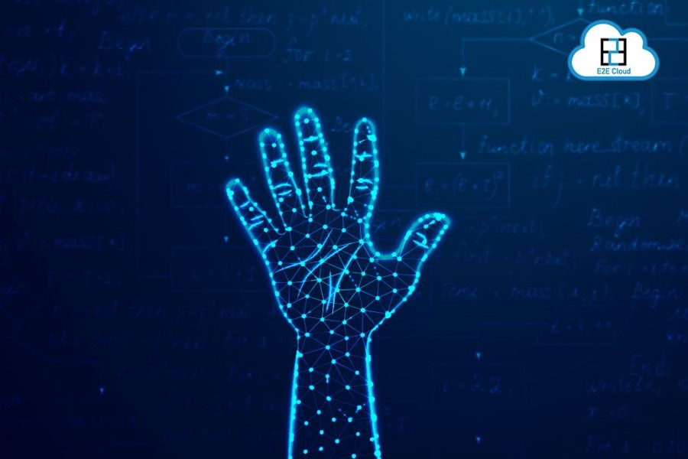
Available Datasets
Hand Gesture Recognition Database with CNN | Accuracy : 99. 95%
Hand gesture recognition using tensor-flow | Accuracy : 96.86%
Hand Gesture recognition using Support Vector Machine (SVM) | Accuracy : >90%

Slide 8
OUR MODEL OF EXECUTION
1.Creatig Our Own Dataset so as We learn how to create datasets and our verstality and freedom to produce any such sign recognition
Link to Dataset Developed -
https://github.com/agrawaldisha/Major_Project_Content/tree/main/Hand_Gesture_ML/Data
Link to Model-https://github.com/agrawaldisha/Major_Project_Content/tree/main/Hand_Gesture_ML/Model
Link to Code-
https://github.com/agrawaldisha/Major_Project_Content/blob/main/Hand_Gesture_ML/test.py
Link to Output Sample-

Slide 9
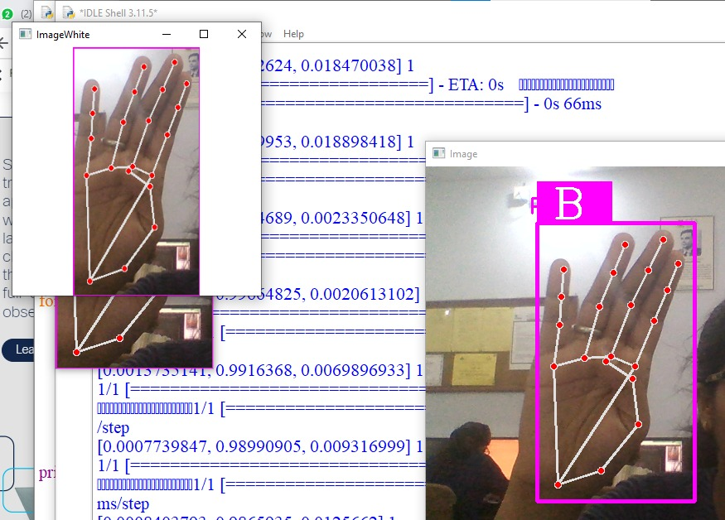
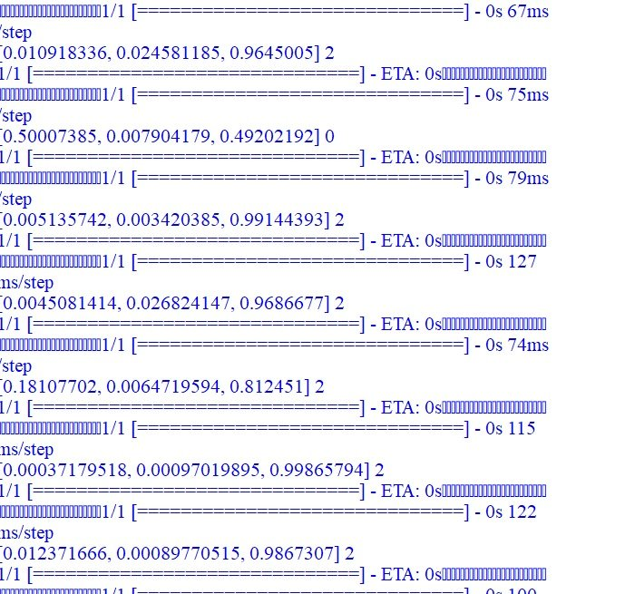

Slide 10
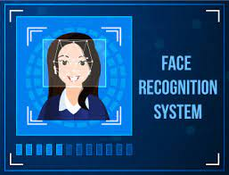
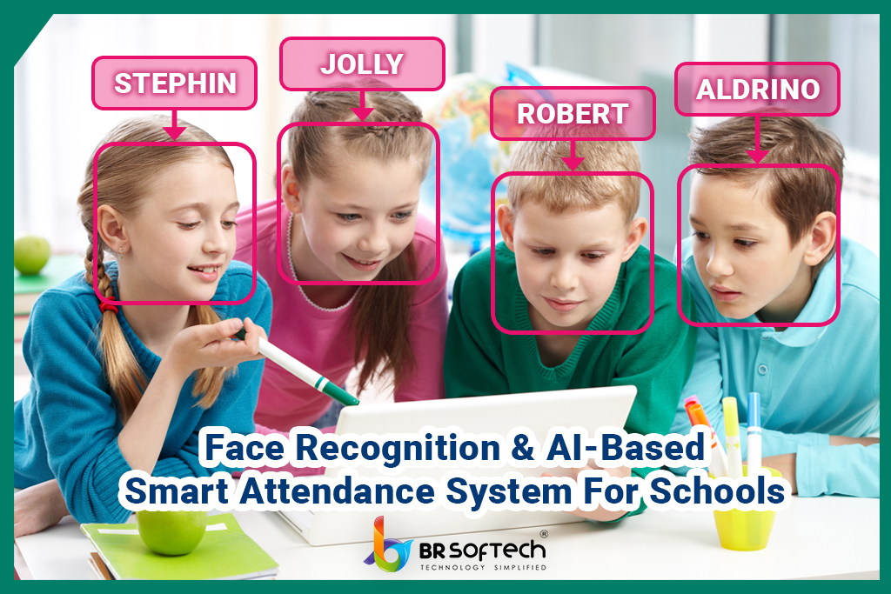
Real- Time Attendence System
(using PyThon)

Slide 11
Face Recognition
WHAT and HOW??
Being Able to detect ,Recognize Faces
Maintain a real time Database
Using Python Libraries and Self-Developed Code to implement
Self made due to low processing

Slide 12
Method for Execution
Develop a Dataset with image labelling
Precprocess the dataset
Develop Encoding of Datset along with their labelled ids
Calculate face-distance
The Lower the distance similar is the face
Get Boolean value as true or false for similarity Quotient

Slide 13
Codes and Sample Output
Link to Encoding Code:-Code For Encoding the Dataset
Link to Implementation Code:-Code for Implemantation File
Link to output :-Link to Database

Slide 14
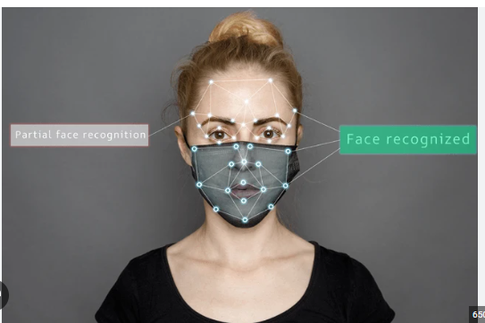
Face Recognition (With Mask)
(using PyThon)

Slide 15
Face Recognition
WHAT and HOW??
possibility of Face recognition while wearing a mask
60%-70% face is hidden
Only Visibility of 30%-40%
Model Trained on a modified CASIA dataset
Dataset has over 8,456,240 images covering 99,892 Celebrities

Slide 16
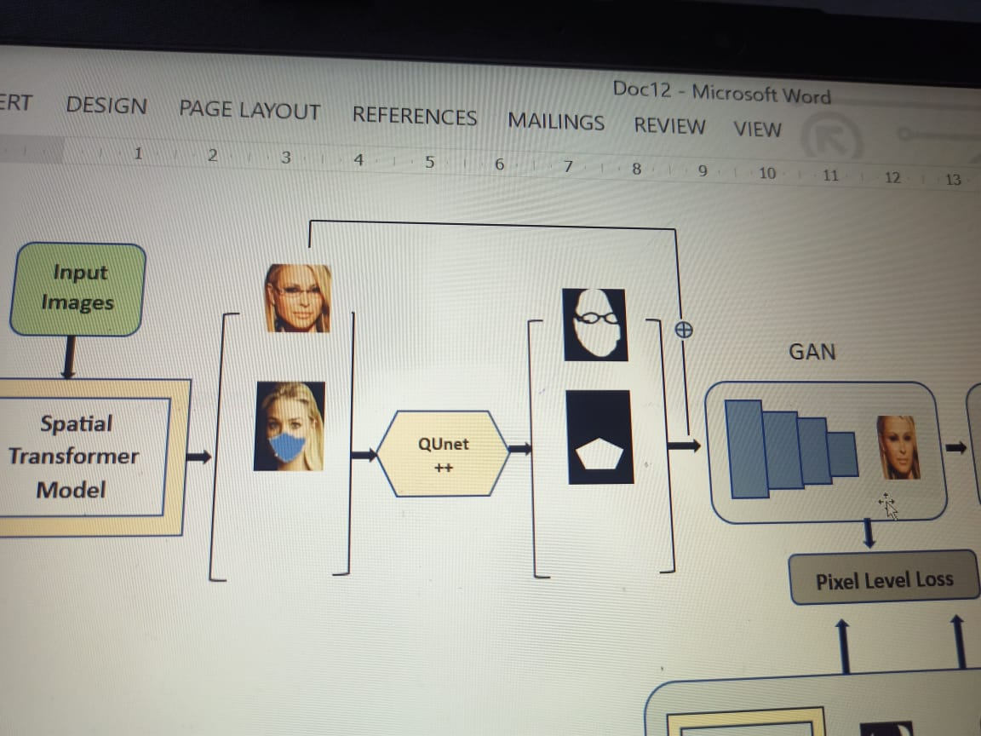
Basic WorkFlow For Face RecogNITION

Slide 17
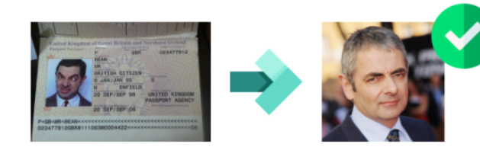
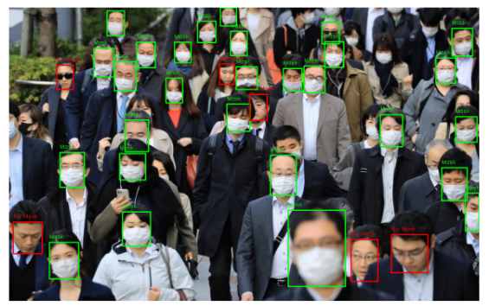
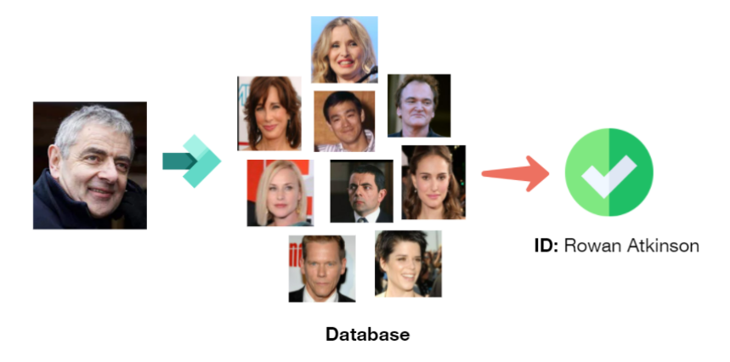
Face Verification Vs Face Recognition

Slide 18
Modern Popular Models
GAN
Spatial Train
Generator and Descriptor
Adversarial Training
Generative Capabilities
Data Preprocessing
Spatial Feature Learning
Model Validation and Prediction

Slide 19
Why Django ???? (Framework to Connect Python Files Easily)
Django
Node Js
Python-based web framework.
a synchronous programming model.
Offers a built-in ORM
rapid development and scalability.
JavaScript runtime environment.
an asynchronous programming model, leveraging non-blocking I/O.
Utilizes npm
Popular for building real-time applications

Slide 20
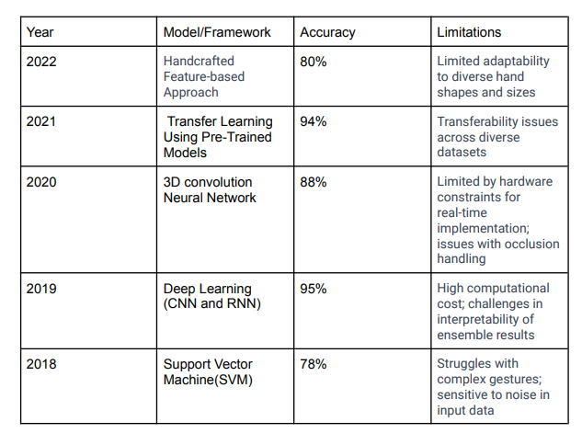
RESEARCH

Slide 21
THANK YOU

Slide 22
Points Left For Consideration Are
1.Joining the pages in the template
2. Accuracy and Model Enhancement for Face Coverence Module

